Slide 1
AMES Housing Analysis
Prepared By: Alan Tan, Russell Foo, Preety Bhogal
17 Jan 2020

Slide 2
Objective
analyse Ames Housing dataset containing information of residential properties sold in Ames (Iowa) from 2006 to 2010
develop a regression model to predict the sale price of houses
provide recommendation for property developers

Slide 3
Overview
Analyzed historical housing sales data in Ames, Iowa
2,051 housing transactions between 2006 and 2010
Sale Prices range from USD 12,789 to USD 611,657
25 neighborhoods

Slide 4
Process
Exploratory data Analysis
Remove outliers
Handle null values in dataset based on group
Feature Engineering (Label and one-hot encoding)
Model selection
Feature filtering
Train model and score
Validate with Kaggle test set

Slide 5
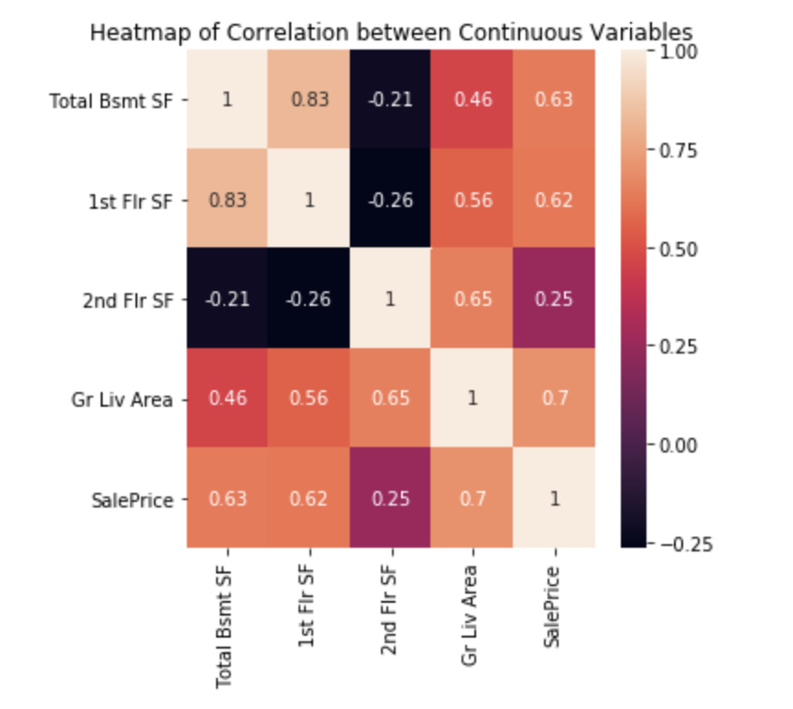
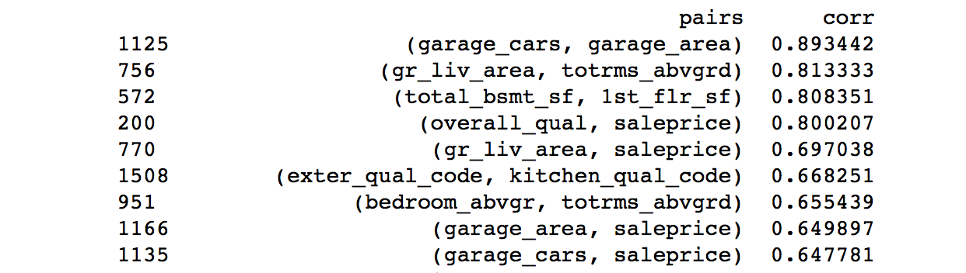
Exploratory Data Analysis (continuous)

Slide 6
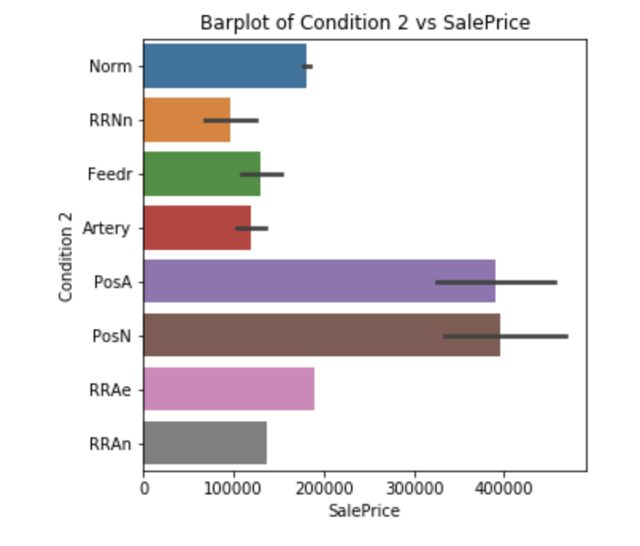
Exploratory Data Analysis (categorical)

Slide 7
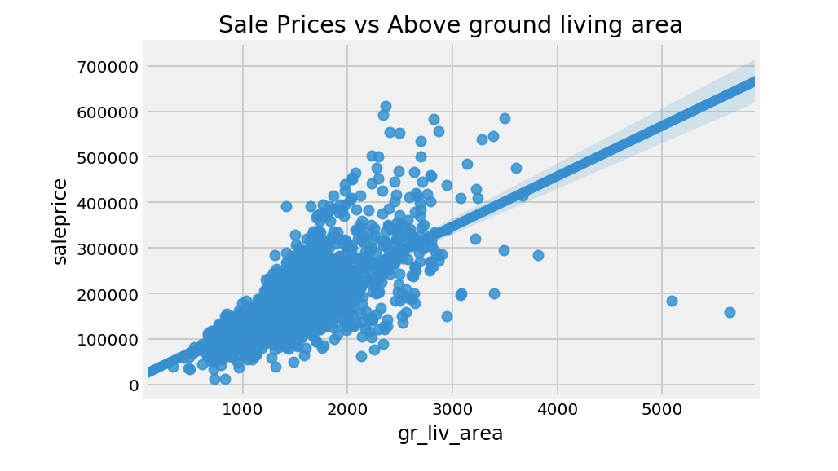
Outliers

Slide 8
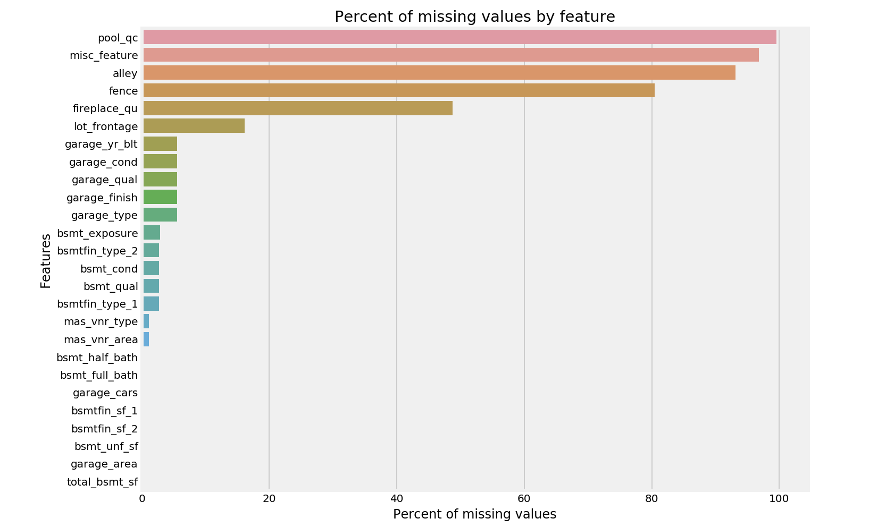
Imputing the null values

Slide 9
Modelling Process
Filtering method
Train three different models with all features
Select model based on the highest adjusted R-squared or lowest mean squared error
Select top 20 variables/coefficients based on the selected model
Re-train the model and test with validation set

Slide 10
Insights from
our model

Slide 11
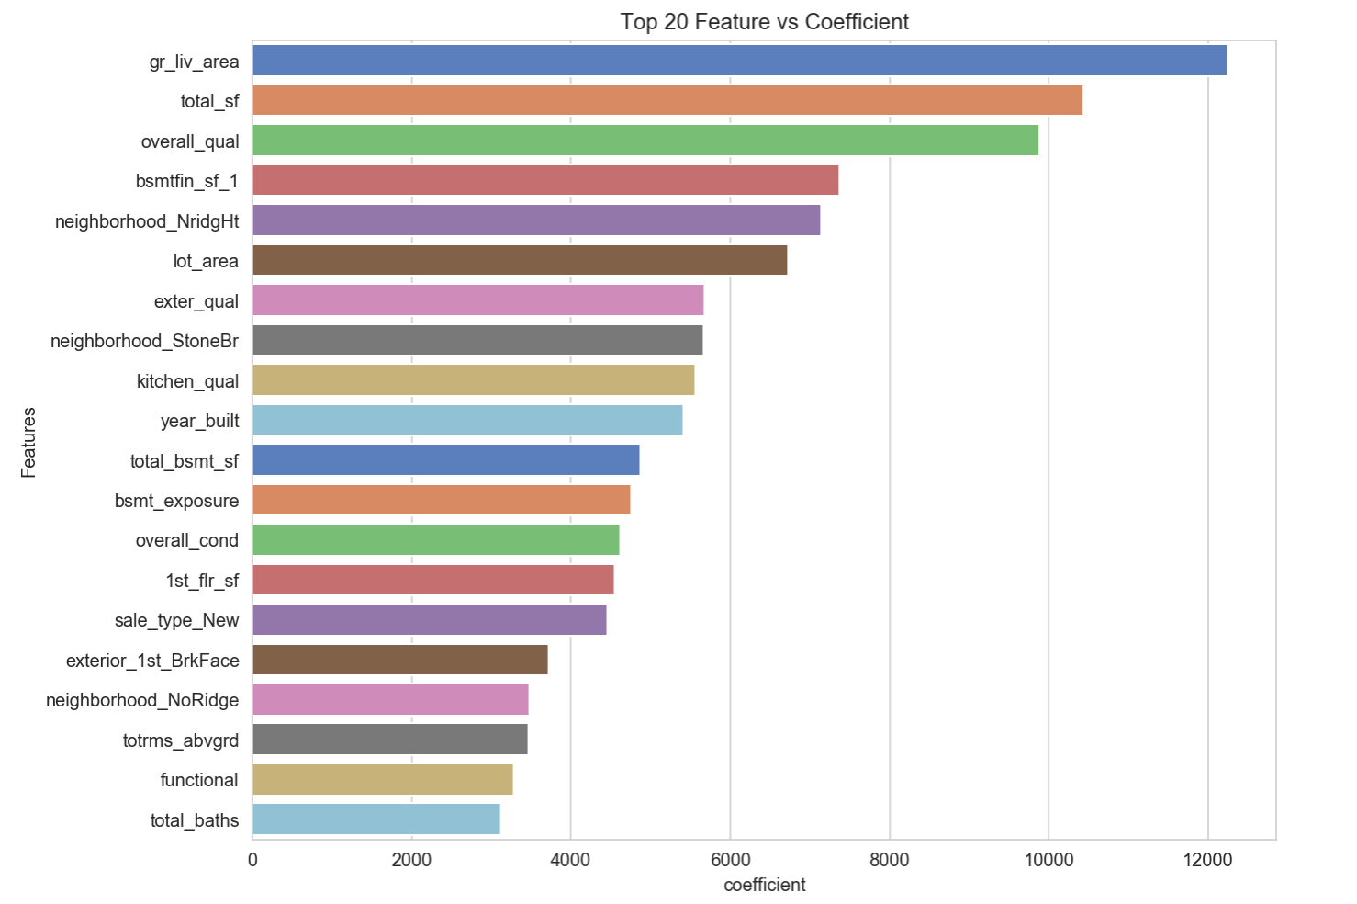
Important Features
Total Surface Area
Overall quality of house
Year Built of the housing unit

Slide 12
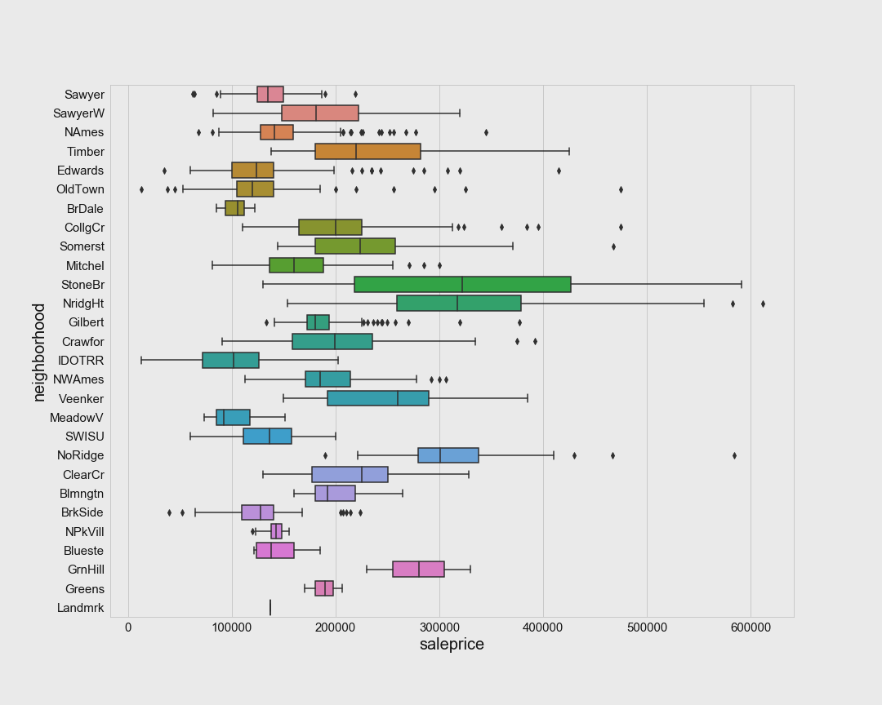
Prime Neighbourhood
North Ridge Heights
Stone Brook

Slide 13
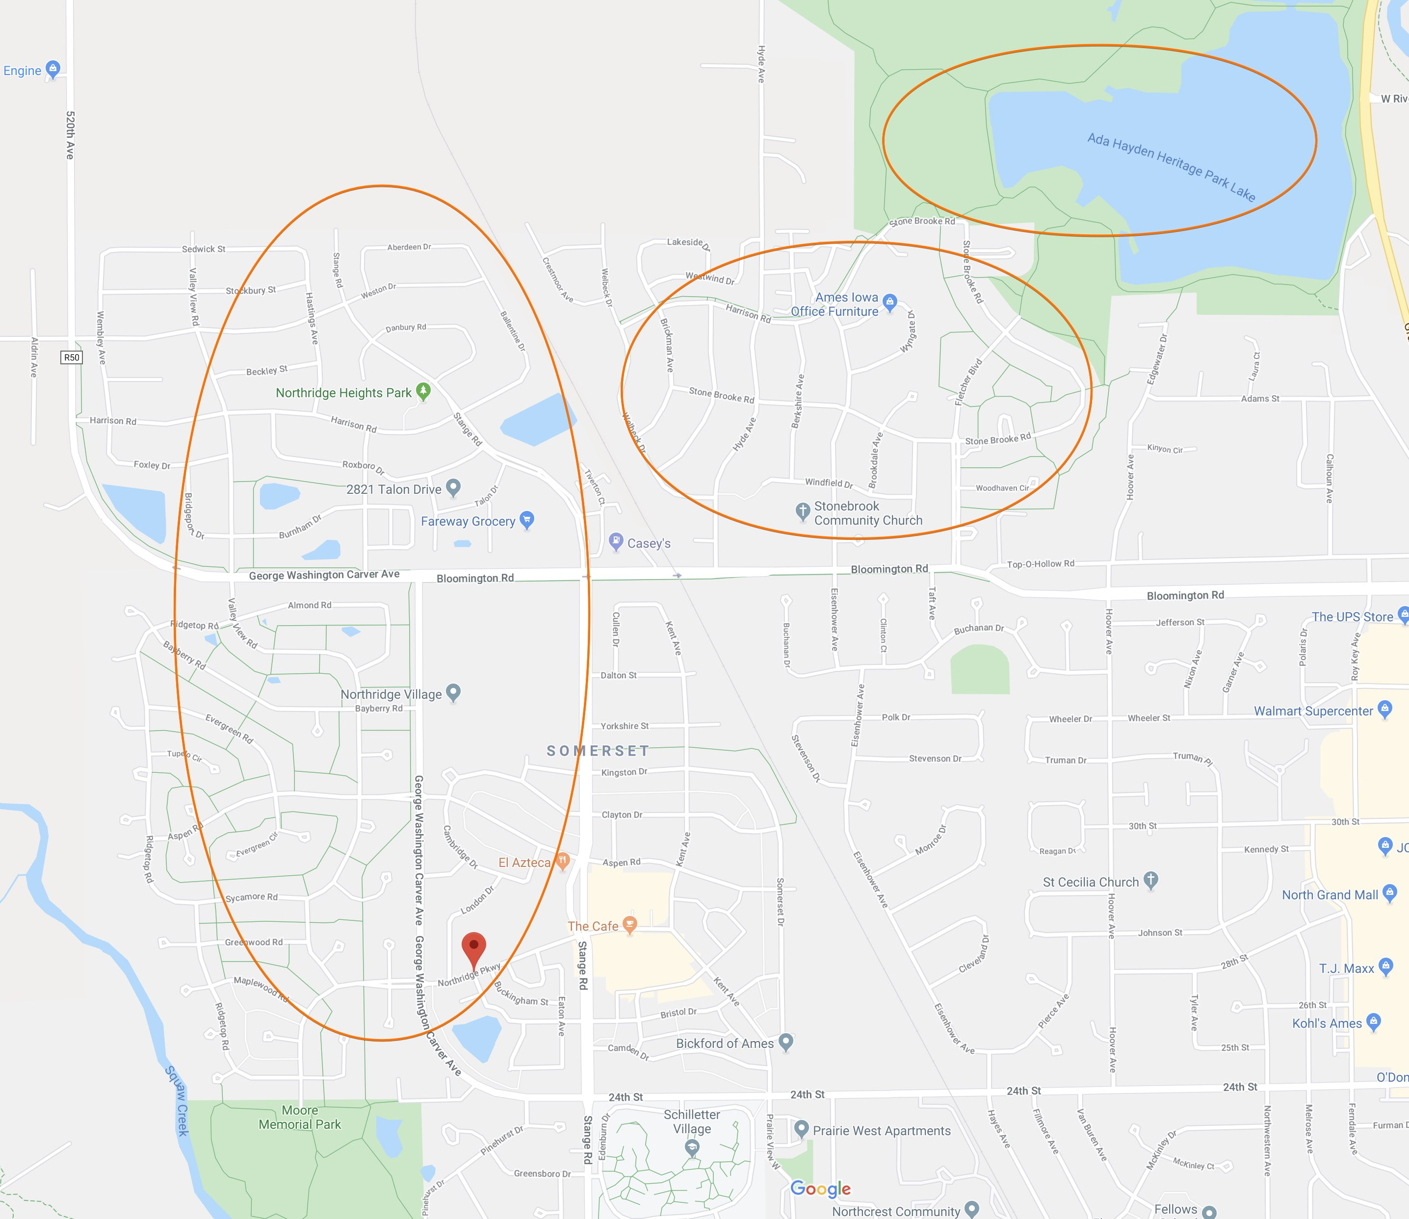

Slide 14
Recommendations
New Property
Surface Area
Neighborhood
Existing Property
Housing Condition
Housing Quality

